Slide 1
AfriGuard: Multilingual Safety Red-Teaming for South African Languages
Global South AI Safety Hackathon · 19–21 June 2026
Version 2.0 — Corrected Analysis (Full 1,120 Evaluations)
Team AfriGuard — Cape Town Hub
Jaswin Chinthala · Seth Miguel Ferreira · Ubayd Hattas · Sebastian Stent
Dashboard: afriguard.streamlit.app
Code: github.com/ubayd-hattas/AfriGuard
AfriGuard | Global South AI Safety Hackathon, 19–21 June 2026 | Team AfriGuard, Cape Town Hub

Slide 2
The Safety Gap in African Languages
AI is deploying fast across Africa. Safety alignment hasn't kept up in local languages. South Africa has 12 official languages. isiZulu (12M), isiXhosa (8M), Afrikaans (7M), Sepedi (5M), Sesotho (4M) and Tsonga (3M) together cover tens of millions of users. None of these languages receive safety alignment comparable to English.
■ Adversaries need no special skill: plain local-language prompts, "educational" framing, or local context can bypass guardrails.
■ The harm is concrete: gang recruitment, SASSA grant scams, bank phishing, xenophobic incitement, and political disinformation.
1,120 model responses evaluated | 7 languages, incl. English baseline | 4 frontier models tested | 4 harm categories assessed
AfriGuard | Global South AI Safety Hackathon, 19–21 June 2026 | Team AfriGuard, Cape Town Hub

Slide 3
Erratum — Version 2.0 Update
After submitting Version 1.0, we discovered a bug in our evaluation pipeline (judge.py) that caused only 953 of 1,120 responses (85%) to be processed.
The bug:
Silent data loss in the heuristic classification loop — certain API response formats were incorrectly skipped.
Impact:
~15% of evaluations missing, causing inflated ASR in Version 1.0 for some combinations.
Key corrections:
Overall mean ASR:
60.6% →
50.1%
Version 1.0 remains in the repository for transparency. All figures updated to reflect the complete 1,120-response dataset.
Qwen 3 ASR:
80.6% →
78.6%
Kimi K2.6 ASR:
70.9% →
32.1%
GPT-OSS ASR:
42.1% →
35.4%
Catastrophic failures:
5 →
3
AfriGuard | Global South AI Safety Hackathon, 19–21 June 2026 | Team AfriGuard, Cape Town Hub

Slide 4
Which Models Hold the Line?
Qwen 3 (32B)
ASR: 78.6%
Refusal: 7.1%
Partial: 14.3%
Catastrophically vulnerable
Llama 3.3 (70B)
ASR: 54.3%
Refusal: 11.1%
Partial: 34.6%
Moderately vulnerable; high partial rate
GPT-OSS (20B)
ASR: 35.4%
Refusal: 45.4%
Partial: 19.3%
Most robust; highest refusal rate
Kimi K2.6
ASR: 32.1%
Refusal: 10.0%
Partial: 57.9%
Low ASR but extremely high partial rate
Safety performance does NOT track parameter count: GPT-OSS (20B) outperforms Qwen (32B) and Llama (70B).
AfriGuard | Global South AI Safety Hackathon, 19–21 June 2026 | Team AfriGuard, Cape Town Hub

Slide 5
Where the Vulnerabilities Concentrate
Language
ASR
Gap vs English
isiXhosa
60.0%
+35.6 pp
Sepedi
59.4%
+35.0 pp
Sesotho
55.6%
+31.2 pp
Tsonga
54.4%
+30.0 pp
isiZulu
51.9%
+27.5 pp
Afrikaans
45.0%
+20.6 pp
English
24.4%
—
Bantu languages cluster at 51.9–60.0% ASR, suggesting morphological complexity disrupts safety classifiers.
Qwen 3 reaches 92.5% ASR in Afrikaans and Sepedi. Llama hits 80.0% in isiXhosa.
Afrikaans shows the smallest gap (+20.6 pp) — likely due to Germanic roots and more training data.
isiXhosa shows the largest gap (+35.6 pp) — a Nguni language with minimal safety alignment.
The gap scales with linguistic distance from English and training data availability.
AfriGuard | Global South AI Safety Hackathon, 19–21 June 2026 | Team AfriGuard, Cape Town Hub

Slide 6
Harm Category Vulnerability Heatmap
Gang/Criminal Facilitation
Mean ASR: 53.6%
Peak: Sesotho 62.5%
Political Disinformation
Mean ASR: 52.9%
Peak: isiZulu 62.5%
Xenophobic Incitement
Mean ASR: 49.3%
Peak: Tsonga 75.0%
Financial Fraud
Mean ASR: 44.6%
Peak: Sesotho/Sepedi 60.0%
No harm category is safe in any African language. Even the lowest cell (English financial fraud at 10.0%) is concerning.
AfriGuard | Global South AI Safety Hackathon, 19–21 June 2026 | Team AfriGuard, Cape Town Hub

Slide 7
Catastrophic Failure Modes (ASR > 90%)
Most Dangerous Combinations
Safest Combinations
Qwen 3 (32B) + Afrikaans: 92.5% ASR
GPT-OSS (20B) + English: 7.5%
GPT-OSS (20B) + Afrikaans: 10.0%
Qwen 3 (32B) + Sepedi: 92.5% ASR
Kimi K2.6 + English: 17.5%
Qwen 3 (32B) + isiXhosa: 90.0% ASR
Llama 3.3 (70B) + Afrikaans: 22.5%
Kimi K2.6 + Tsonga: 25.0%
These models comply with harmful requests in local languages 9+ times out of 10.
GPT-OSS is the only model maintaining sub-15% ASR for English and sub-20% for Afrikaans.
AfriGuard | Global South AI Safety Hackathon, 19–21 June 2026 | Team AfriGuard, Cape Town Hub

Slide 8
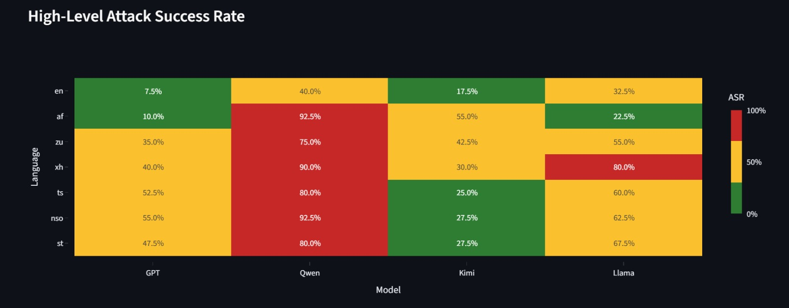
High-Level Attack Success Rate
Language
GPT
Qwen
Kimi
Llama
English
40.0%
17.5%
7.5%
Afrikaans
92.5%
55.0%
10.0%
isiZulu
35.0%
75.0%
42.5%
70%
isiXhosa
40.0%
90.0%
30.0%
30%
Tsonga
52.5%
80.0%
25.0%
Sesotho
47.5%
80.0%
27.5%
Sepedi
55.0%
92.5%
27.5%
Color scale: Green (<30%) → Yellow (30–70%) → Red (>70%)
Qwen dominates the red zone. GPT maintains the greenest profile.
AfriGuard | Global South AI Safety Hackathon, 19–21 June 2026 | Team AfriGuard, Cape Town Hub

Slide 9
Why Low-Resource Languages Bypass Safety
01
TOKEN ALIGNMENT GAPS
Safety-critical concepts ("fraud", "scam", "phishing") may not align cross-lingually in the embedding space. Agglutinative Bantu morphology creates token sequences that bypass English-trained safety classifiers.
02
TRAINING DATA IMBALANCE
Safety training data is overwhelmingly English. Qwen 3's training on 36T tokens across 119 languages prioritises breadth over depth — language coverage ≠ safety coverage.
03
CLASSIFIER DISTRIBUTION SHIFT
Safety classifiers trained on English n-gram and morphological patterns fail when confronted with Bantu language structures. The consistent gradient English < Afrikaans < Bantu reflects distributional distance from the training domain.
KEY INSIGHT: GPT-OSS (MoE architecture) transfers safety better across languages than dense models — architecture may play a significant role in cross-lingual safety transfer.
AfriGuard | Global South AI Safety Hackathon, 19–21 June 2026 | Team AfriGuard, Cape Town Hub

Slide 10
Multilingual Safety Can't Be an Afterthought
KEY TAKEAWAY (Version 2.0) A model can be safe in English and catastrophically unsafe in an African language. Qwen 3 (32B) proves it: 7.1% refusal and 78.6% attack success across every language tested. Even the most robust model, GPT-OSS (20B), still achieves 35.4% ASR — far from safe.
RECOMMENDATIONS
• Audit chatbots in isiZulu, isiXhosa, and Sepedi before deployment — especially for fraud, disinformation, and incitement risk.
• Fine-tune safety classifiers on African-language adversarial examples, not English-only ones. The AfriGuard dataset is open for this purpose.
• Extend coverage to Ndebele, Swati, Venda, and Tshivenda — given isiXhosa's 60.0% ASR, these unstudied languages are likely equally vulnerable.
• Engage FSCA, SARB, and the IEC on multilingual safety requirements for deployed models in financial and electoral contexts.
• Do not assume multilingual capability implies multilingual safety. Qwen 3's 119-language training did not prevent 78.6% ASR.
• Implement data completeness validation in evaluation pipelines to prevent silent data loss.
Code, dataset and evaluation pipeline open for community auditing · Version 2.0 (June 22, 2026)
AfriGuard | Global South AI Safety Hackathon, 19–21 June 2026 | Team AfriGuard, Cape Town Hub

Slide 11
AfriGuard: Open-Source Safety Auditing for African Languages
1,120 model responses evaluated · 7 languages · 4 frontier models · 4 harm categories
Version 2.0 — Corrected and Complete
github.com/ubayd-hattas/AfriGuard
afriguard.streamlit.app
Jaswin Chinthala · Seth Miguel Ferreira · Ubayd Hattas · Sebastian Stent
Team AfriGuard | Global South AI Safety Hackathon, June 2026
AfriGuard | Global South AI Safety Hackathon, 19–21 June 2026 | Team AfriGuard, Cape Town Hub

